Slide 1
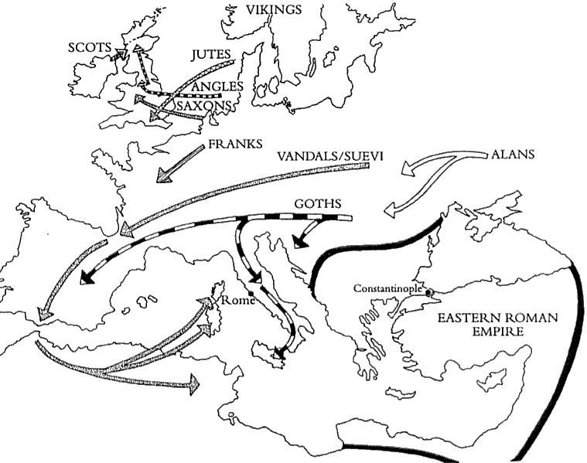
Cause: Weak Leadership
In 200 CE: The Good Emperors of Rome fell into a series of Civil Wars.
Invasions threatened the east and the west.

Slide 2
Causes: Weak Leadership
Emperors increased the size of the army straining the economy.
This caused the empire to become a kind of military dictatorship.

Slide 3
Cause
Social Unrest
Insecurity
Civil Wars and invasions led to an increase in robbery and piracy on Roman roads and trade routes.
Made travel hazardous and caused merchants to fear shipping goods

Slide 4
Cause: Economic Crisis
Military needs caused Emperors to raise taxes.
Rome was no longer expanding, conquests no longer brought in new sources of wealth.
Emperors minted new coins with copper and lead as well as silver in order to maintain the money supply.
People began to refuse to accept the currency at its face value.

Slide 5
Cause: Economic Crisis
Caused inflation-increased prices for goods and services combined with the reduced value of money.

Slide 6
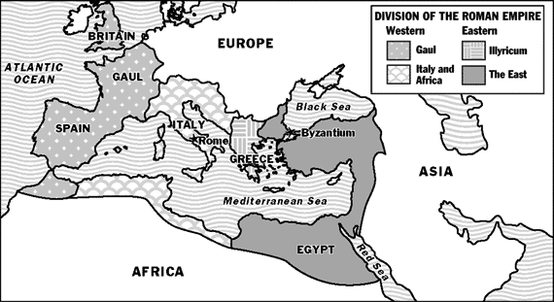
Cause: Invasions
AD 410 the Visigothic King Alaric sacked Rome.
2. Mid-400's AD Attila the Hun attacked Gaul.

Slide 7
Cause: Invasions
3. Roman army couldn't stop him alone so they joined with the Visigoths and defeated the Huns.
4. Attila began to head towards Rome.
5. Before Attila got to Rome Pope Leo I persuaded Attila to leave Italy.
6. 476 Odoacer overthrew the last Roman emperor; many consider this as the end of the Western Roman Empire.

Slide 8
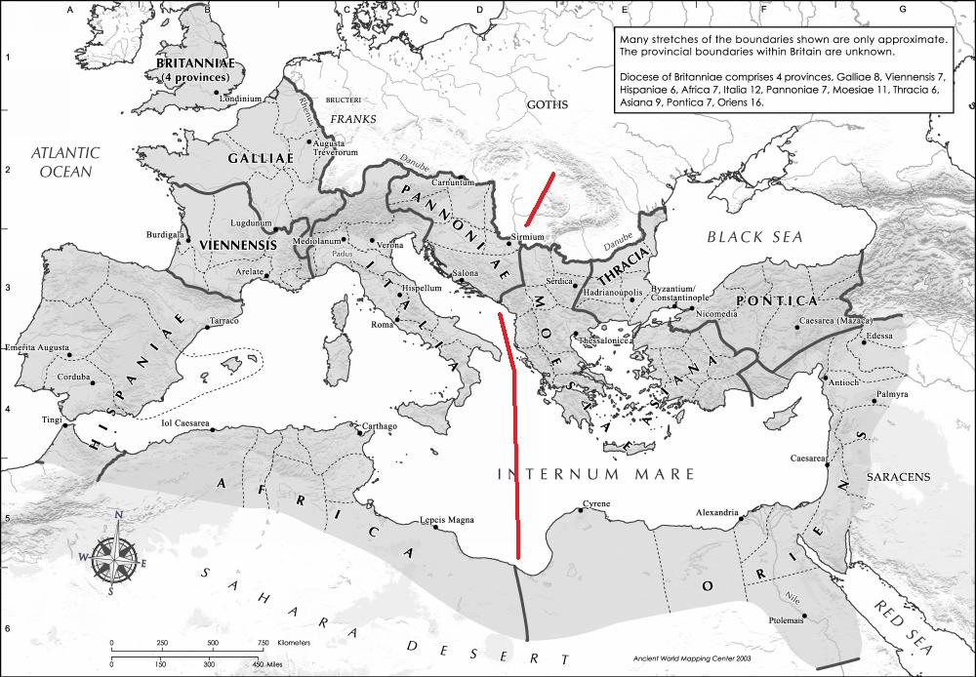
Effects
East
The continuation of the Roman Empire ruled from Constantinople.

Slide 9
Effects
West
The disappearance of central authority and the creation of smaller kingdoms.

